Slide 1
Chapter 22:
ELECTROSTATICS

Slide 2
This lecture will help you understand:
Electrical Forces and Charges
Conservation of Charge
Coulomb’s Law
Conductors and Insulators
Superconductors
Charging
Charge Polarization
Electric Field
Electric Potential
Electric Energy Storage

Slide 3
Electricity
Electricity is the name given to a wide range of electrical phenomena, such as
  lightning.
  spark when we strike a match.
  what holds atoms together.
Electrostatics involves electric charges,
  the forces between them,
  the aura that surrounds them, and
  their behavior in materials.

Slide 4
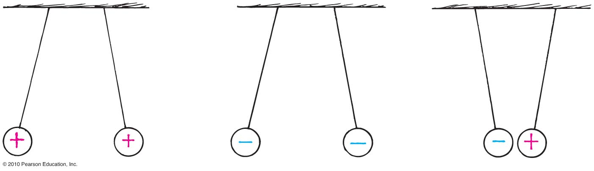
Electric Force and Charges
Electrostatics involves the phenomena of electrical charges at rest.
Which particles that are positively charged or negatively charged are based on choices defined by Benjamin Franklin.
Central rule of electricity
Opposite charges attract one another; like charges repel.

Slide 5
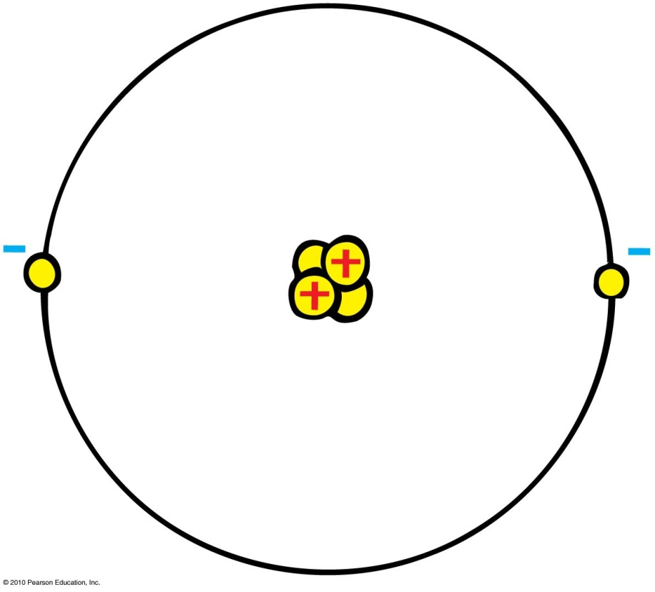
Electric Force and Charges
Protons
Positive electric charges
Repel positives, but attract negatives
Electrons
Negative electric charges
Repel negatives, but attract
positives
Neutrons
Neutral electric charge

Slide 6
Electric Force and Charges
Fundamental facts about atoms
1. Every atom is composed of a positively charged nucleus surrounded by negatively charged electrons.
2. Each of the electrons in any atom has the same quantity of negative charge and the same mass.

Slide 7
Electric Force and Charges
Fundamental facts about atoms (continued)
3. Protons and neutrons compose the nucleus. Protons are about 1800 times more massive than electrons, but each one carries an amount of positive charge equal to the negative charge of electrons. Neutrons have slightly more mass than protons and have no net charge.
4. Atoms usually have as many electrons as protons, so the atom has zero net charge.

Slide 8
Electric Force and Charges
Ion
Positive ion—atom losing one or more electrons has positive net charge.
Negative ion—atom gaining one or more electrons has negative net charge.

Slide 9
Electric Force and Charges
Electrons in an atom
Innermost—attracted very strongly to oppositely charged atomic nucleus
Outermost—attracted loosely and can be easily dislodged

Slide 10
Electric Force and Charges
Electrons in an atom
Examples:
  When rubbing a comb through your hair, electrons transfer from your hair to the comb. Your hair has a deficiency of electrons (positively charged).
  When rubbing a glass rod with silk, electrons transfer from the rod onto the silk and the rod becomes positively charged.

Slide 11
When you brush your hair and scrape electrons from your hair, the charge of your hair is
Electric Force and Charges
CHECK YOUR NEIGHBOR
A. positive.
negative.
Both A and B.
Neither A nor B.
Notes:
A. positive.

Slide 12
When you brush your hair and scrape electrons from your hair, the charge of your hair is
Electric Force and Charges
CHECK YOUR ANSWER
A. positive.
negative.
Both A and B.
Neither A nor B.
Comment:
And if electrons were scraped off the brush onto your hair, your hair would have a negative charge.
Notes:
A. positive.

Slide 13

Conservation of Charge
Conservation of charge
In any charging process,
no electrons are created
or destroyed. Electrons
are simply transferred from
one material to another.

Slide 14
Conservation of Charge
The number of electrons and protons in neutral atoms are equal.
When one or more electron is removed from an atom a positive ion is formed.
When more electrons are added to an atom a negative ion is formed.
Atoms or materials having an unequal number electrons or protons are said to be electrically charged.
When electrons are transferred from one material to another charge is conserved.
The amount of charged transferred is quantized.

Slide 15
Coulomb’s Law
Coulomb’s law
Relationship among electrical force, charge, and distance discovered by Charles Coulomb in the 18th century
Electrical force like gravity is inversely proportional to the square of the distance between the charged particles
For a pair of charged objects that are much smaller than the distance between them, the force between them varies directly, as the product of their charges, and inversely, as the square of the separation distance

Slide 16
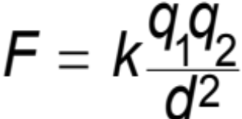
Coulomb’s Law
Coulomb’s law (continued)
If the charges are alike in sign, the force is repelling; if the charges are not alike, the force is attractive.
In equation form:
k = 9,000,000,000 Nm²/C²
Unit of charge is coulomb, C
The electron charge is 1.6 x10⁻¹⁹ C
Similar to Newton’s law of gravitation for masses
Underlies the bonding forces between molecules

Slide 17
Two point charges are separated by 6 cm. The attractive force between them is 20 N. Find the force between them when they are separated by 12 cm. (Why can you solve this problem without knowing the magnitudes of the charges?)
F(0.06m) = k q₁ q₂ / (0.06)² so F(0.12m) = k q₁ q₂ / (0.12)²
F(0.12m) / F(0.06m) = (0.06)² / (0.12)² since F(0.06m) = 20N
Then F(0.12m) = 20 x (0.06/0.12)² = 20 /(2)² = 20 / 4
F(0.12m) = 5 N
2. If the charges attracting each other in the problem above have equal magnitude, what is the magnitude of each charge?
Since q₁ = q₂ then F(0.06m) = k q² / (0.06)² and
q² = F(0.06m) / k (0.06)² ] = 20 /(9x10⁹ x 36 x 10⁻⁴)
q² = 8 x 10⁻¹² C2 or q = 2.8 x10⁻⁶ C

Slide 18
According to Coulomb’s law, a pair of particles that are placed twice as far apart will experience forces that are
Coulomb’s Law
CHECK YOUR NEIGHBOR
A. half as strong.
one-quarter as strong.
twice as strong.
4 times as strong.
Notes:
B. one quarter as strong.

Slide 19
According to Coulomb’s law, a pair of particles that are placed twice as far apart will experience forces that are
Coulomb’s Law
CHECK YOUR ANSWER
A. half as strong.
one-quarter as strong.
twice as strong.
4 times as strong.
Notes:
B. one quarter as strong.

Slide 20
Coulomb’s Law
Differences between gravitational and electrical forces
  Electrical forces may be either attractive or repulsive.
  Gravitational forces are only attractive.

Slide 21
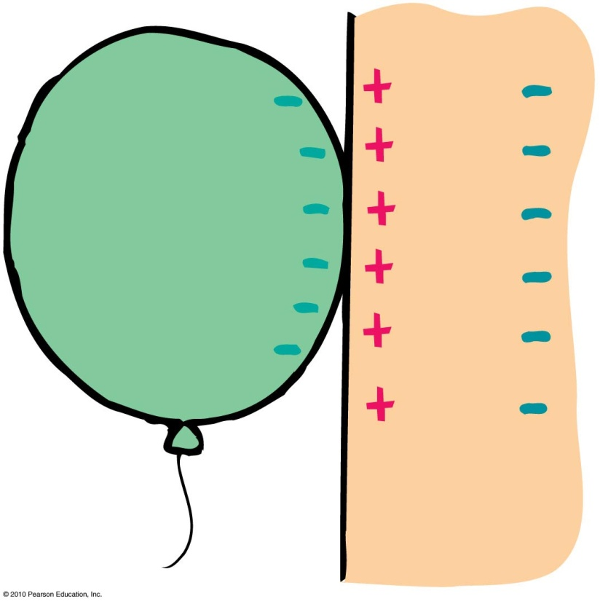
Coulomb’s Law
Charge polarization
Atom or molecule in which the charges are aligned with a slight excess of positive charge on one side and slight excess of negative charge on the other
Example: Rub an inflated balloon on
your hair and place the
balloon on the wall. The
balloon sticks to the wall
due to charge polarization in
the atoms or molecules of
the wall.

Slide 22
Conductors and Insulators
Conductor: Materials in which one or more of the electrons in the outer shell of its atoms are not anchored to the nuclei of particular atoms but are free to wander in the material
  Example: Metals such as copper and aluminum
Insulators: Materials in which electrons are tightly bound and belong to particular atoms and are not free to wander about among other atoms in the material, making them flow
  Example: Rubber, glass

Slide 23
Conductivity of Materials
Material | Electrical Conductivity (S·m⁻¹) | Notes
Silver | 63.0 × 10⁶ | Best electrical conductor of any known metal
Copper | 59.6 × 10⁶ | Commonly used in electrical wire applications due to very good conductivity and price compared to silver.
Annealed Copper | 58.0 × 10⁶ | Referred to as 100% IACS or International Annealed Copper Standard. The unit for expressing the conductivity of nonmagnetic materials by testing using the eddy-current method. Generally used for temper and alloy verification of Aluminium.
Gold | 45.2 × 10⁶ | Gold is commonly used in electrical contacts because it does not easily corrode.
Aluminium | 37.8 × 10⁶ | Commonly used for High Voltage Mains electricity distribution cables.
Sea water | 4.8 | Corresponds to an average salinity of 35 g/kg at 20 °C.^{[1]}
Drinking water | 0.0005 to 0.05 | This value range is typical of high quality drinking water and not an indicator of water quality
Deionized water | 5.5 × 10⁻⁶ | Conductivity is lowest with mono atomic gases present; changes to 1.2 × 10⁻⁴ upon complete de-gassing, or to 7.5 × 10⁻⁵ upon equilibration to the atmosphere due to dissolved CO₂
Jet A-1 Kerosene | 50 to 450 × 10⁻¹²
n-hexane | 100 × 10⁻¹²
Air | 0.3 to 0.8 × 10

Slide 24
Conductors and Insulators
Semiconductors: A material that can be made to behave sometimes as an insulator and sometimes as a conductor.
  Fall in the middle range of electrical resistivity between insulators and conductors.
  They are insulators when they are in their pure state.
  They are conductors when they have impurities.
Semiconductors conduct when light shines on it.
  If a charged selenium plate is exposed to a pattern of light, the charge will leak away only from the areas exposed to light.

Slide 25
When you buy a water pipe in a hardware store, the water isn’t included. When you buy copper wire, electrons
Conductors and Insulators
CHECK YOUR NEIGHBOR
A. must be supplied by you, just as water must be supplied for a water pipe.
are already in the wire.
may fall out, which is why wires are insulated.
None of the above.
Notes:
B. are already in the wire.

Slide 26
When you buy a water pipe in a hardware store, the water isn’t included. When you buy copper wire, electrons
Conductors and Insulators
CHECK YOUR ANSWER
A. must be supplied by you, just as water must be supplied for a water pipe.
are already in the wire.
may fall out, which is why wires are insulated.
None of the above.
Notes:
B. are already in the wire.

Slide 27
Superconductors
Superconductors: Materials acquire zero resistance (infinite conductivity) to the flow of charge.
  Once electric current is established in a superconductor, the electrons flow indefinitely.
  With no electrical resistance, current passes through a superconductor without losing energy.
  No heat loss occurs when charges flow.

Slide 28
Charging
Charging by friction and contact.
Example:
  Stroking cats fur, combing your hair, rubbing your shoes on a carpet
Electrons transfer from one material to another by simply touching. For example,
  when a negatively charged rod is placed in contact with a neutral object, some electrons will move to the neutral object.

Slide 29
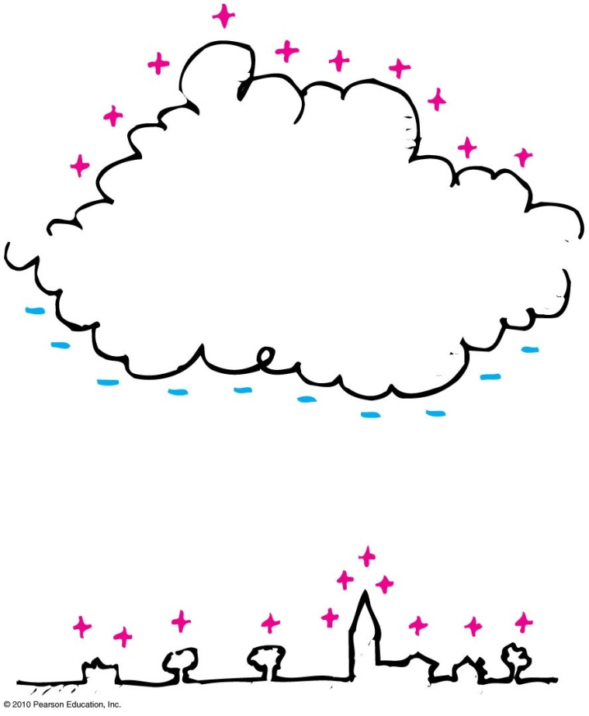
Charging
Charging by induction
  If you bring a charged object near a conducting surface, electrons are made to move in the surface material, even without physical contact.
  Example: The negative charge at the bottom of the cloud induces a positive charge on the buildings below.

Slide 30
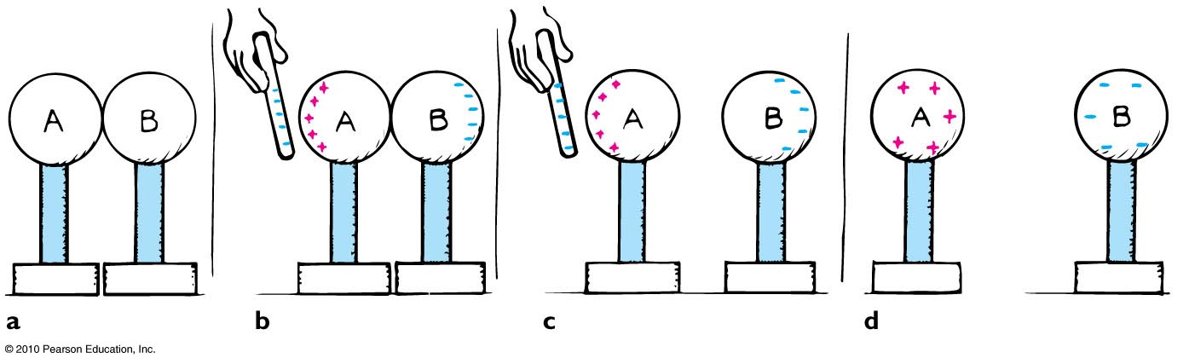
Charging
Induction: Consider two insulated metal spheres A and B.
They touch each other, so in effect they form a single uncharged conductor.
When a negatively charged rod is brought near A, electrons in the metal, being free to move, are repelled as far as possible until their mutual repulsion is big enough to balance the influence of the rod. The charge is redistributed.
If A and B are separated while the rod is still present, each will be equal and oppositely charged.

Slide 31
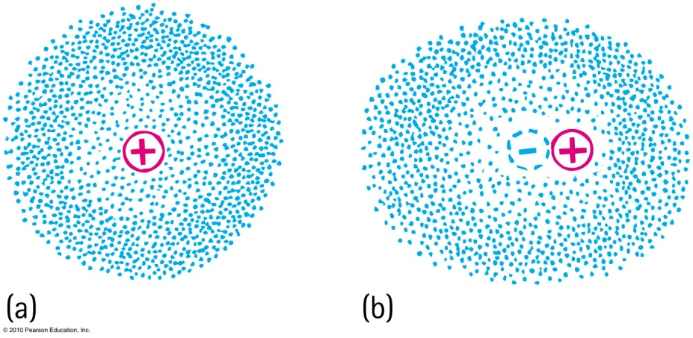
Charge Polarization
One side of the atom or molecule is induced into becoming more negative (or positive) than the opposite side. The atom or molecule is said to be electrically polarized.
An electron buzzing around the atomic nucleus produces an electron cloud.
a. The center of the negative cloud normally coincides with the center of the positive nucleus in an atom.
b. When an external negative charge is brought nearby to the right, the electron cloud is distorted so that the centers of negative and positive charge no longer coincide. The atom is now electrically polarized

Slide 32
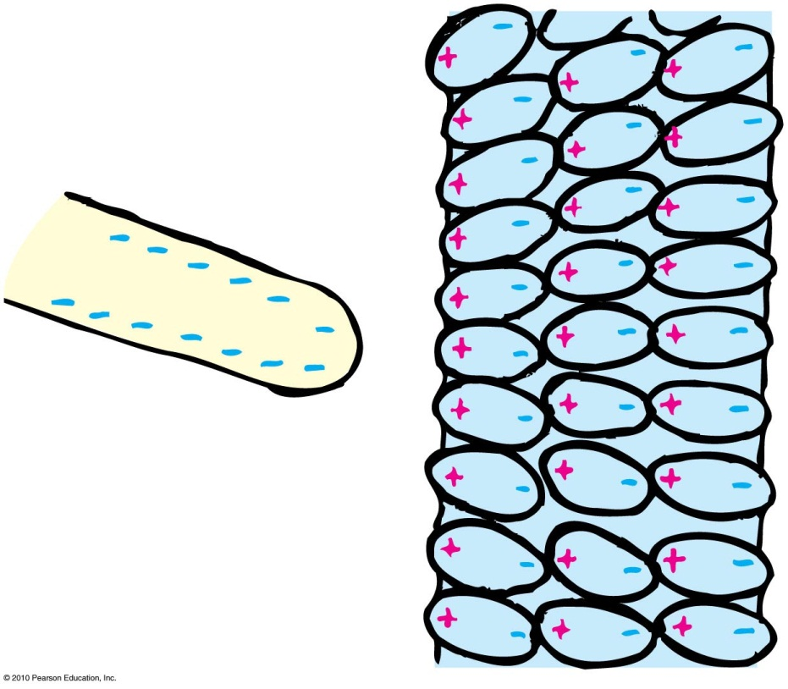
Charge Polarization
If the charged rod is negative, then the positive part of the atom or molecule is tugged in a direction toward the rod, and the negative side of the atom or molecule is pushed in a direction away from the rod.
The positive and negative parts of the atoms and molecules become aligned. They are electrically polarized.

Slide 33
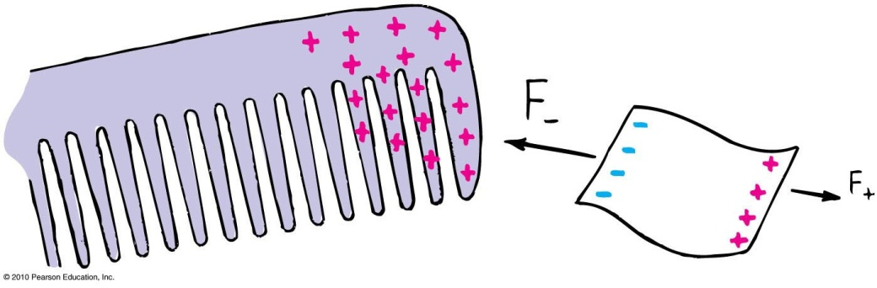
Charge Polarization
When a charged comb is brought nearby, molecules in the paper are polarized.
The sign of charge closest to the comb is opposite to the comb’s charge.
Charges of the same sign are slightly more distant. Closeness wins, and the bits of paper experience a net attraction.

Slide 34

Charge Polarization
Rub an inflated balloon on your hair, and it becomes charged.
Place the balloon against the wall, and it sticks.
This is because the charge on the balloon induces an opposite surface charge on the wall.
Again, closeness wins, for the charge on the balloon is slightly closer to the opposite induced charge than to the charge of same sign

Slide 35
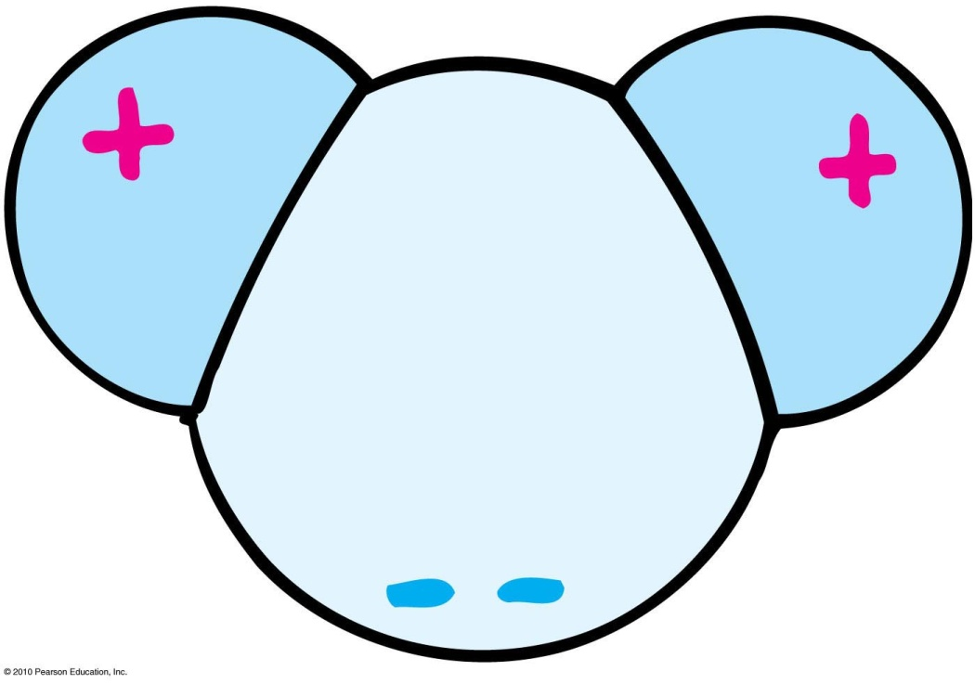
Charge Polarization
Many molecules—H₂O, for example—are electrically polarized in their normal states.
The distribution of electric charge is not perfectly even.
There is a little more negative charge on one side of the molecule than the other.
Such molecules are said to be electric dipoles.

Slide 36
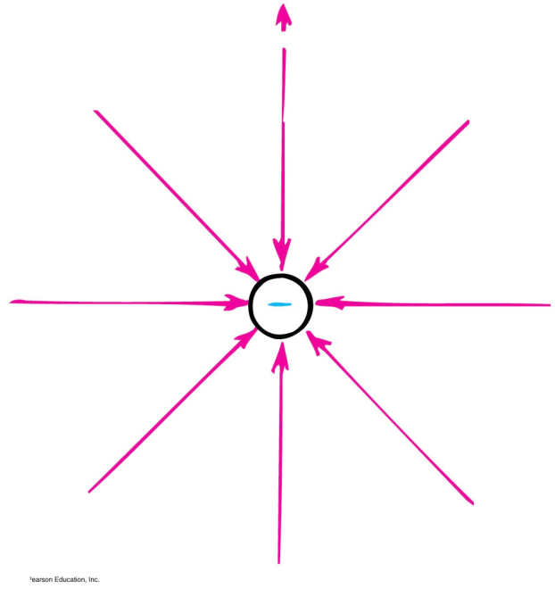
Electric Field
Electric field
Space surrounding an electric charge (an energetic aura)
Describes electric force
Around a charged particle obeys inverse-square law
Force per unit charge

Slide 37
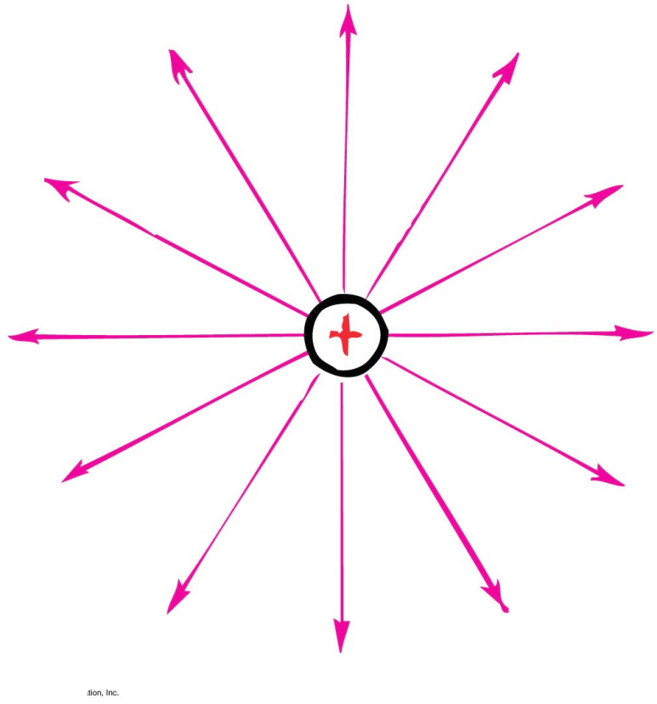
Electric Field
Electric field direction
Same direction as the force on a positive charge
Opposite direction to the force on an electron

Slide 38
Electric Field
Electrical forces like gravitational forces act without contact. These forces are described in terms of a field.
Like gravity charges produce an electric field which influences other objects and charged particles.
Fields are vectors that have both a magnitude and a direction.
The magnitude of the electric field, E, is the force per unit charge. E = F/q
A useful way to understand the electric field is to describe it in terms of its lines of force.

Slide 39
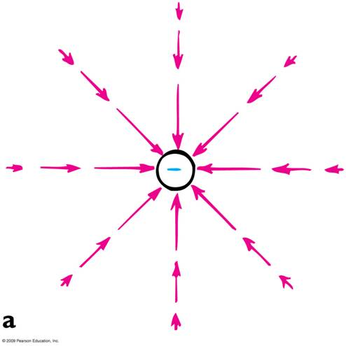
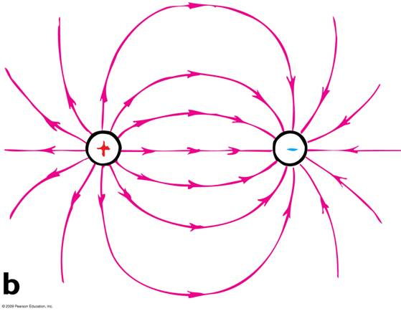
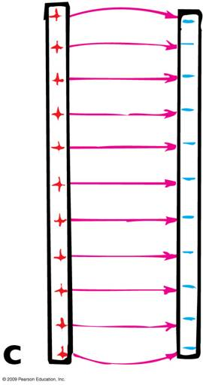
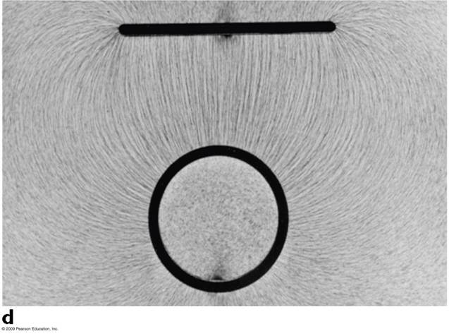
Electric Field Lines

Slide 40
4. Electronic types neglect the force of gravity on electrons. To see why, compute the force of Earth's gravity on an electron and compare it with the force exerted on the electron by an electric field of magnitude 10,000 V/m (a relatively small field). The mass and charge of an electron are given on the inside
back cover.
F(grav) = mg = (9.1 x 10^{–31} kg)(9.8 m/s2) = 8.9 x 10^{–30} N.
F(elec) = qE = (1.6 x 10^{–19} C)(10,000 V/m) = 1.6 x 10^{–15} N, more than 10¹⁴ times larger than the gravitational force!

Slide 41
6. A droplet of ink in an industrial ink-jet printer carries a charge of 1 .6 X 10⁻¹⁰ C and is deflected onto paper by a force of 3.2 X 1 0⁻⁴ N. Find the strength of the electric field to produce this force.
E = F/ q = 3.2 X 1 0⁻⁴ N / 1 .6 X 10⁻¹⁰ C = 2 x 10⁶ N/C or V/m

Slide 42
Electrical Field
Like gravity charged objects have an electrical potential.
Work changes the electrical potential i.e. a charge moved in an electric field requires work and likewise a charge released in an electric field can do work.
electric potential = electric potential energy/ charge
1 volt = 1 joule / coulomb
The electric potential has a value that can be assigned to a specific location.
This is the basis for describing electric circuits.
High voltage only results in high energy if a large charge is involved.

Slide 43
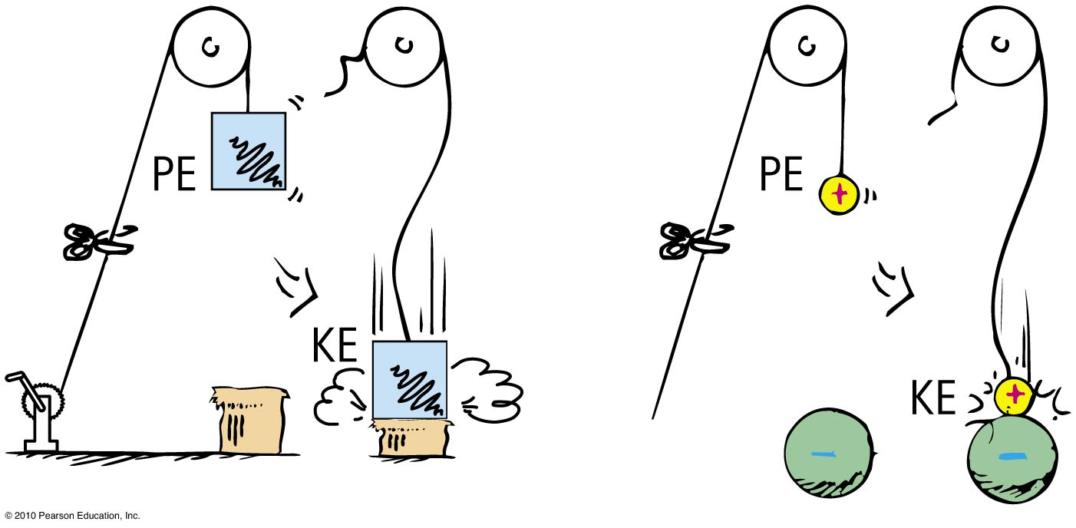
Electric Potential
Electric potential energy
Energy possessed by a charged particle due to its location in an electric field. Work is required to push a charged particle against the electric field of a charged body.

Slide 44
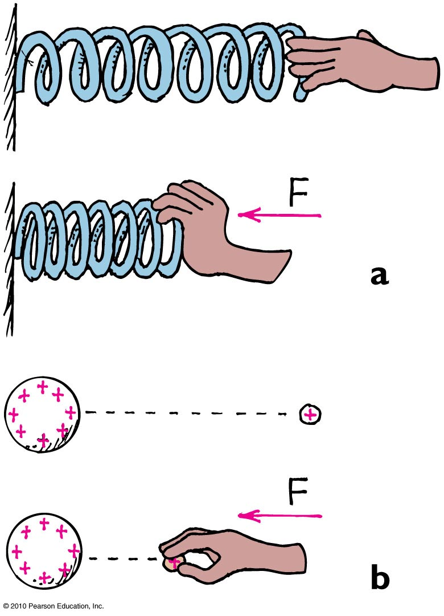
Electric Potential
(a) The spring has more elastic PE when compressed. (b) The small charge similarly has more PE when pushed closer to the charged sphere. In both cases, the increased PE is the result of work input.

Slide 45
Electric Potential
Electric potential (voltage)
Energy per charge possessed by a charged particle due to its location
May be called voltage—potential energy per charge
In equation form:
electric potential energy
Electric potential =
amount of charge

Slide 46
8. An energy of 0.1 J is stored in the metal ball on top of a Van de Graaff generator. A spark carrying 1 micro-coulomb (10⁻⁶ C) discharges the ball. What was the ball's potential relative to ground?
Potential is defined as energy per unit charge, so
V = PE/q = (0.1 J)/(10⁻⁶ C) =
= 1 x 10⁵ V or 100,000 V.

Slide 47
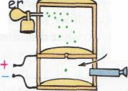
10. In 1909, Robert Millikan was the first to find the charge of an electron in his now-famous oil-drop ex­periment. In that experiment tiny oil drops were sprayed into a uniform electric field between a horizontal pair of oppositely charged plates. The drops were observed with a magnifying eyepiece, and the electric field was adjusted so that the upward force on some negatively charged oil drops was just sufficient to balance the downward force of gravity. That is, when suspended, upward force qE just equaled mg. Millikan accurately measured the charges on many oil drops and found the values to be whole-number multiples of 1.6 X 10⁻¹⁹ C, the charge of the electron. For this he won the Nobel prize. Questions: (a) If a drop mass of 1.1 x 10⁻¹⁴ kg remains stationary in an electric field of 1.68 x 10⁵ N/C, what is the charge of this drop? (b) How many extra electrons are on this particular oil drop (given the presently known charge of the electron)?
(a) From E = F/q q =F/E = mg/E
So q = (1.1 x 10-14)(9.8)/1.68 x 105)
q = 6.4 x 10⁻¹⁹ C.
(b) Number of electrons = 6.4 x 10⁻¹⁹C/ 1.6 x10⁻¹⁹ C/e
Number of electrons = 4 electrons.

Slide 48
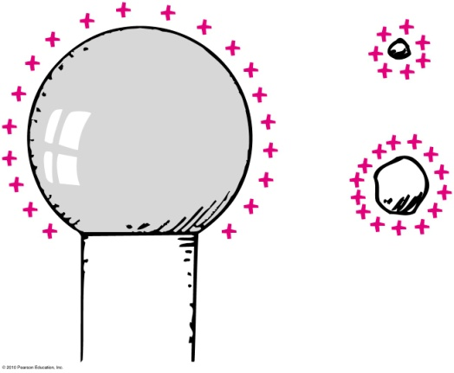
Electric Potential
Electric potential (voltage) (continued)
Unit of measurement: volt,
Example:
  Twice the charge in same location has twice the electric potential energy but the same electric potential.
  3 times the charge in same location has 3 times the electric potential energy but the same electric potential (2 E/2 q = 3 E/3 q = V)
1 volt =
1 joule
1 coulomb

Slide 49
Electric potential energy is measured in joules. Electric potential, on the other hand (electric potential energy per charge), is measured
Electric Potential
CHECK YOUR NEIGHBOR
A. in volts.
in watts.
in amperes.
also in joules.
Notes:
A. in volts.

Slide 50
Electric potential energy is measured in joules. Electric potential, on the other hand (electric potential energy per charge), is measured
Electric Potential
CHECK YOUR ANSWER
A. in volts.
in watts.
in amperes.
also in joules.
Notes:
A. in volts.

Slide 51
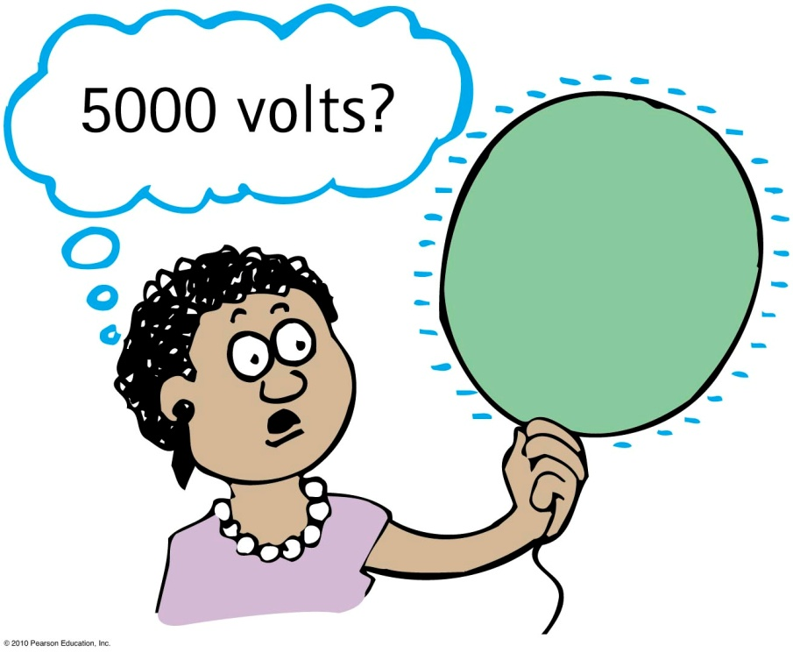
Electric Potential
Electric potential (voltage) (continued)
High voltage can occur at low electric potential energy for a small amount of charge.
High voltage at high electric potential energy occurs for lots of charge.

Slide 52
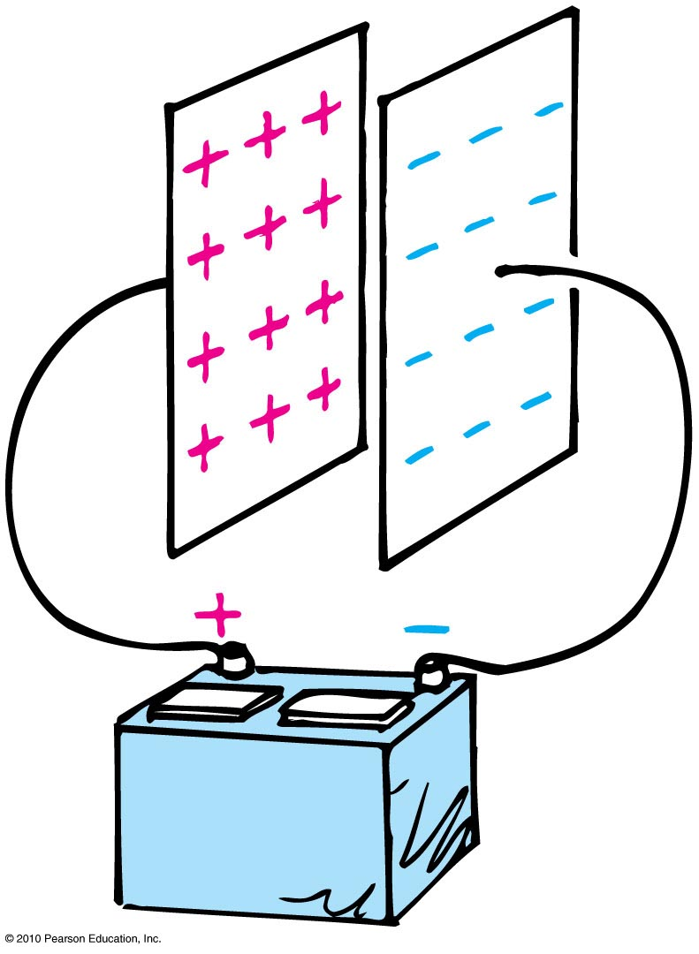
Electric Energy Storage
Electrical energy can be stored in a common device called a capacitor.
The simplest capacitor is a pair of conducting plates separated by a small distance, but not touching each other.
When the plates are connected to a charging device, such as the battery, electrons are transferred from one plate to the other.

Slide 53
Electric Energy Storage
This occurs as the positive battery terminal pulls electrons from the plate connected to it.
These electrons, in effect, are pumped through the battery and through the negative terminal to the opposite plate.
The capacitor plates then have equal and opposite charges:
  The positive plate connected to the positive battery terminal, and
  The negative plate connected to the negative terminal.

Slide 54
Electric Energy Storage
The charging process is complete when the potential difference between the plates equals the potential difference between the battery terminals—the battery voltage.
The greater the battery voltage, and the larger and closer the plates, the greater the charge that can be stored.
The energy stored in a capacitor comes from the work required to charge it.
Discharging a charged capacitor can be a shocking experience if you happen to be the conducting path.

Slide 55
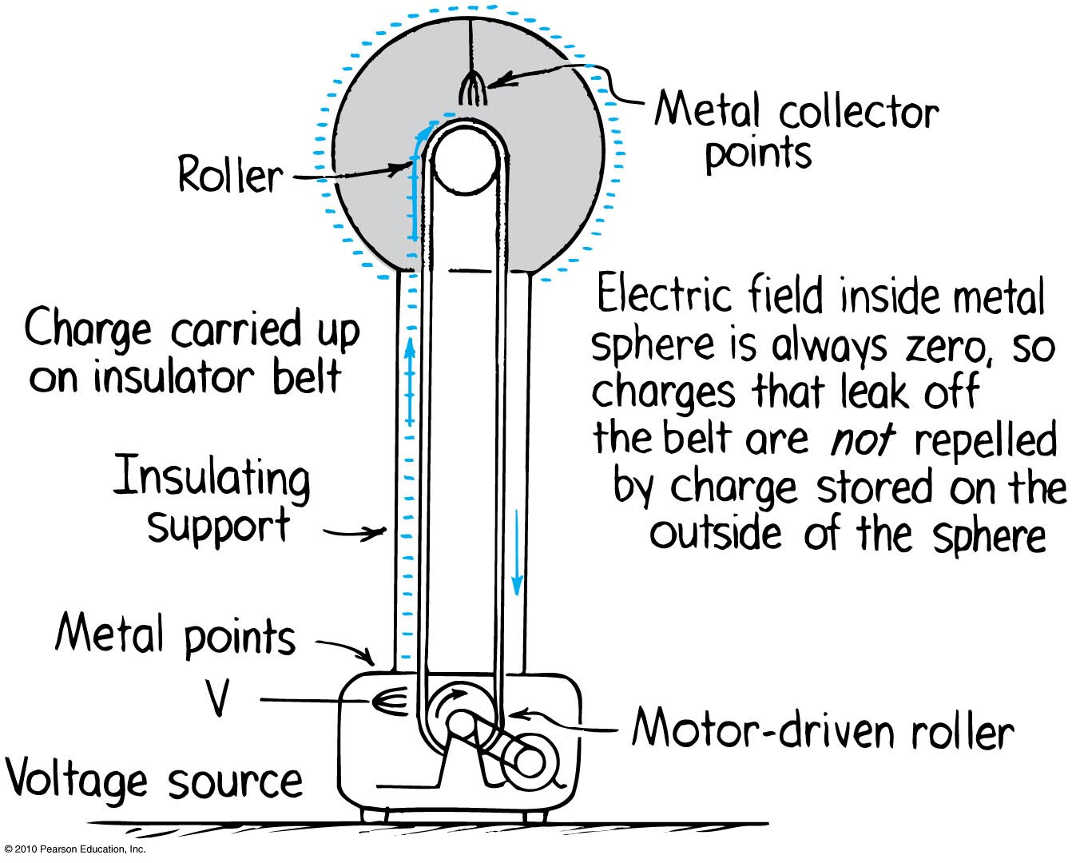
Electric Energy Storage
A common laboratory device for producing high voltages and creating static electricity is the Van de Graaff generator.

